Slide 1
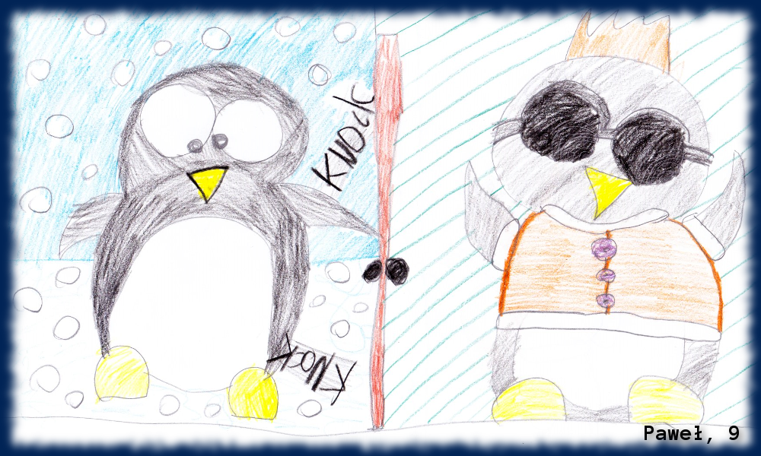
Knock, knock, knock
Linux at your door
Bartosz Bielawski, Optiver

Slide 2
Agenda
Scenario
Solutions
Current: pywinrm
Future: PSRP
What could possibly…?

Slide 3
Scenario
Linux in control
Windows doing the job
Seamless experience
Security IS important

Slide 4
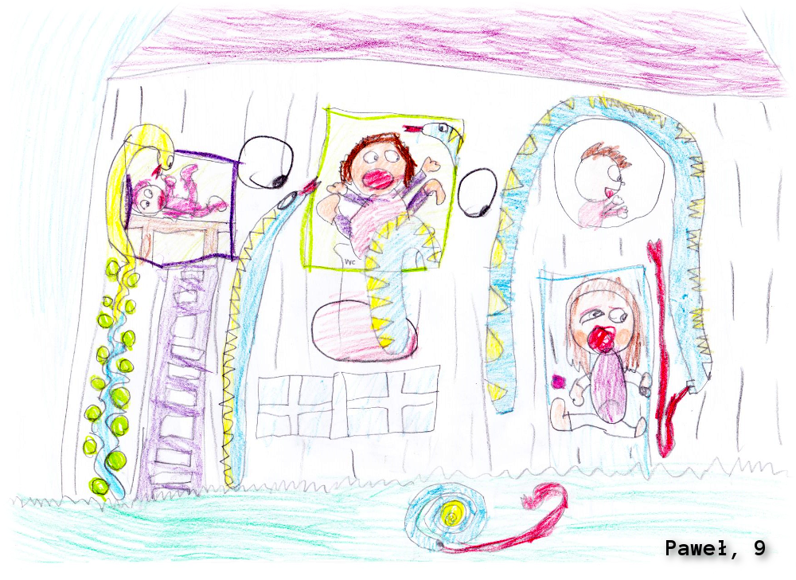
Demo

Slide 5
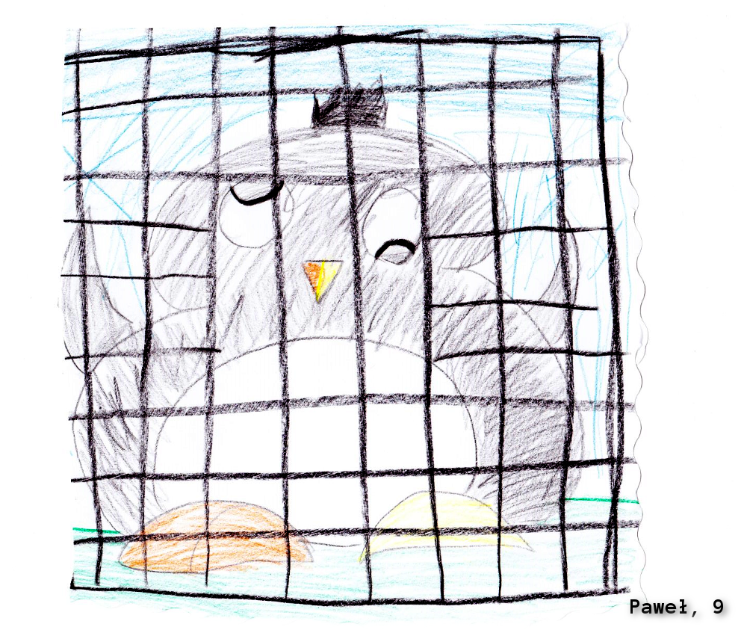
Demo

Slide 6

Summary
PowerShell on Linux – bright future
Python – xplat language of the present
Xplat PowerShell – just a first step

Slide 7
Next Steps...
Now: 15 min break
Grab a coffee
Stay here to enjoy next presentation
Change track and switch to another room
Ask me questions or meet me in a breakout session room afterwards

Slide 8
about_Bartek.help.txt
Windows Engineer @ Optiver
MVP: PowerShell Cloud Something Something
Book author: „PowerShell 5.0 Biblia“ (PL)
PowerShellMagazine.com/PowerShellPL.NET
Optiver is hiring!
DevOps Engineer
…?

